Slide 1
Numerical Analysis (6/7) Linear systems
University of Luxembourg - 2024
Master in Mathematics
Hadrien Beriot

Slide 2
Outline
1. Introduction
2. Direct Methods
3. Iterative methods
4. Summary

Slide 3

1. Introduction

Slide 4
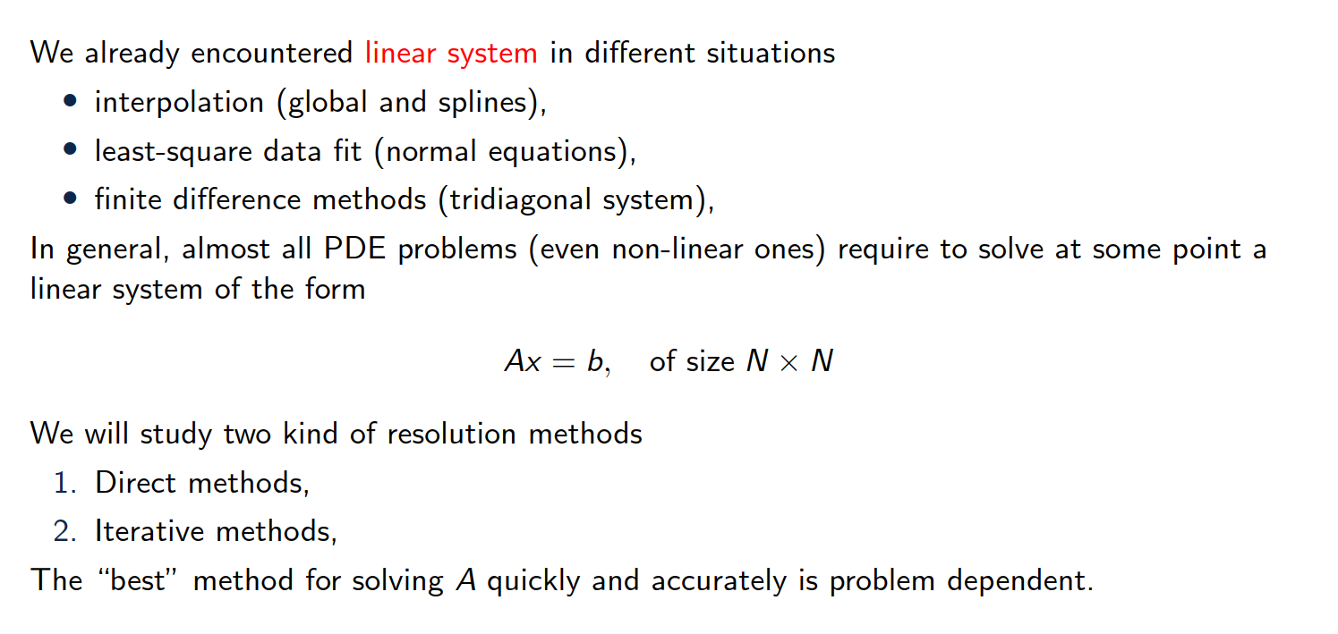
Overview of the content
Notes:
The image represents a Lorenz attractor, which is a three-dimensional chaotic attractor discovered by the mathematician Edward Lorenz.
The Lorenz attractor is a graphical representation of the solutions to a set of differential equations that describe a simplified model of atmospheric convection, known as the "Butterfly effect".
The image shows the characteristic butterfly-like shape of the Lorenz attractor, which demonstrates the sensitive dependence on initial conditions that is a hallmark of chaotic systems.

Slide 5
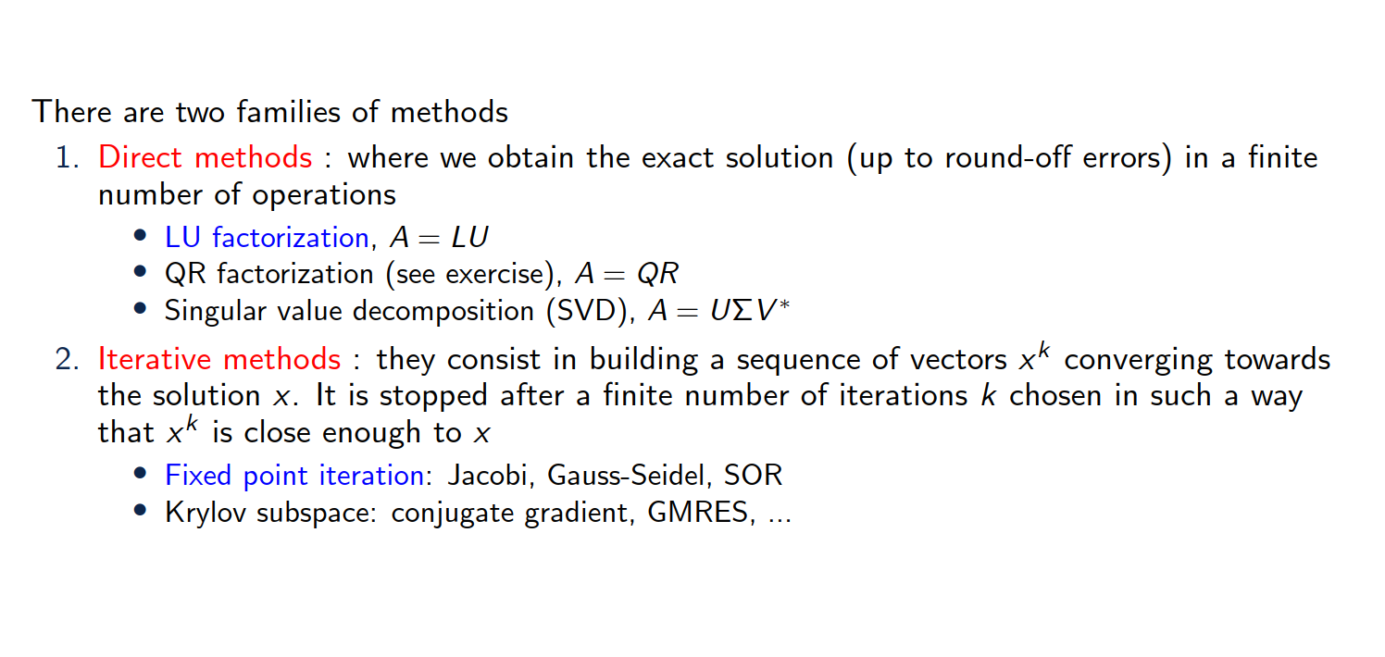
Overview of the content

Slide 6
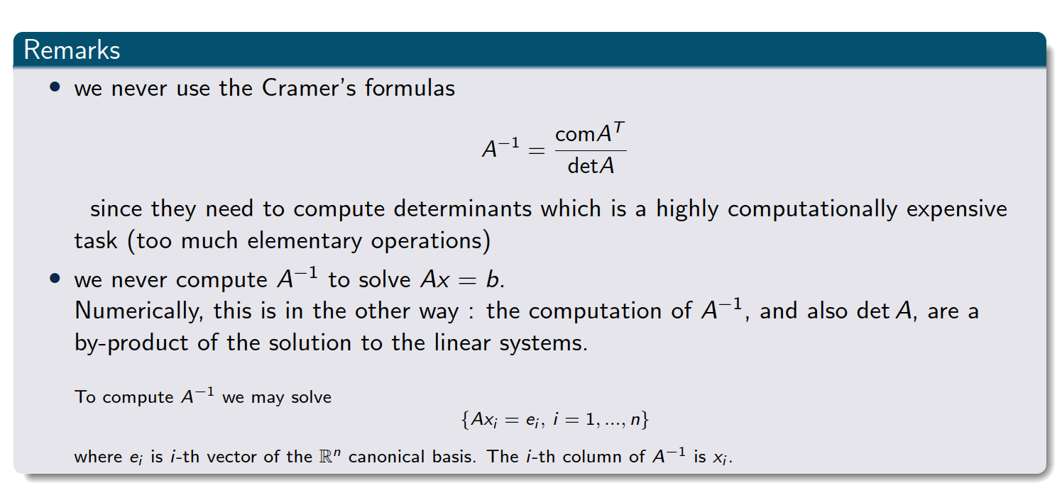
Important remarks
Notes:
The comatrix of a matrix AAA is the transpose of the matrix of cofactors of AAA.Each cofactor is obtained by calculating the determinant of the submatrix that remains after removing the row and column corresponding to the element in question, with an appropriate sign adjustment based on the position.

Slide 7
2. LU factorization

Slide 8
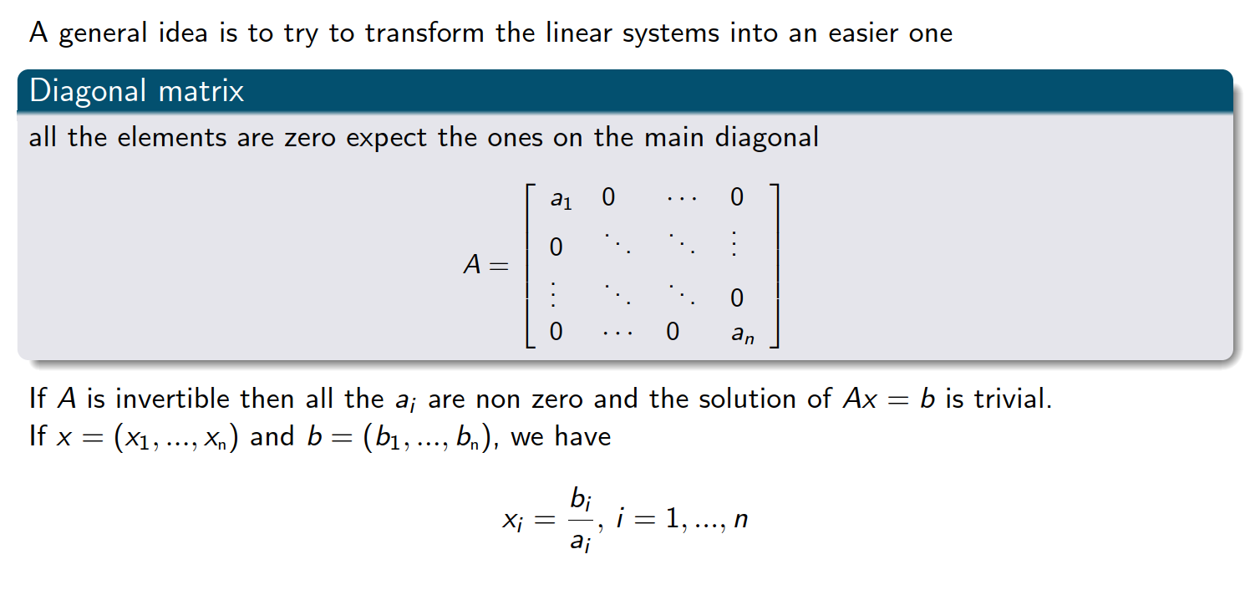
Linear system that is easy to solve

Slide 9
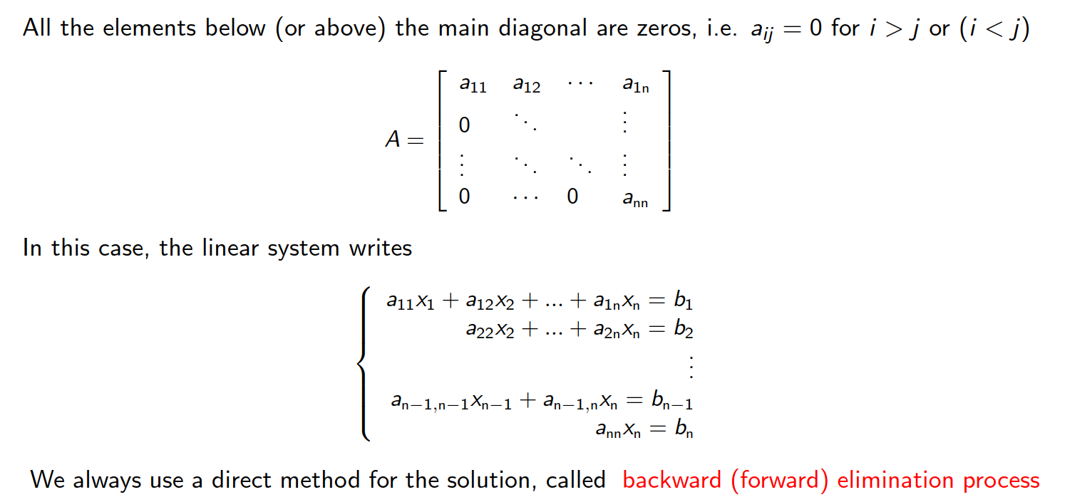
Upper (or lower) triangular matrices

Slide 10
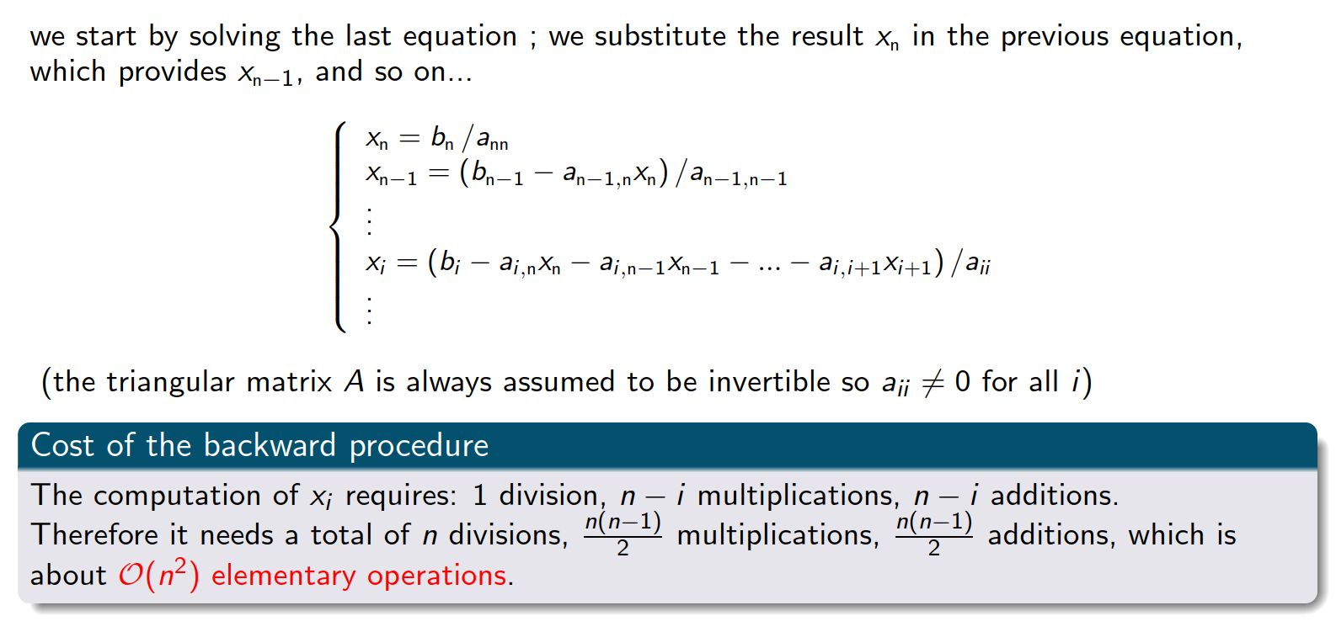
Backward substitution
Exercise 1

Slide 11
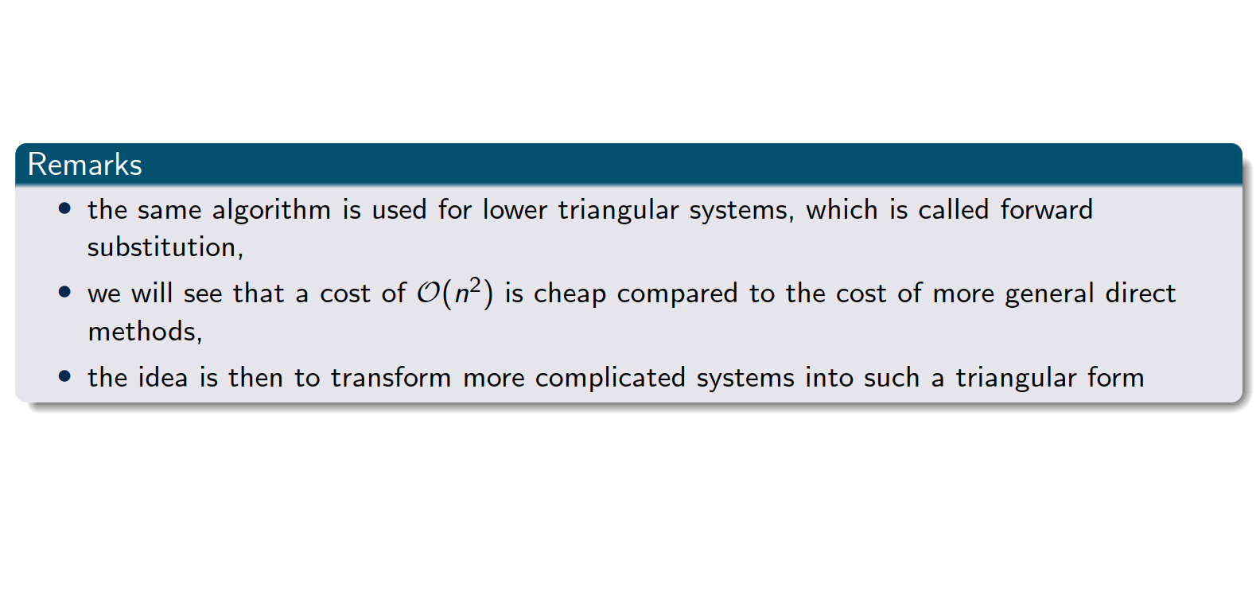
Upper (or lower) triangular matrices

Slide 12
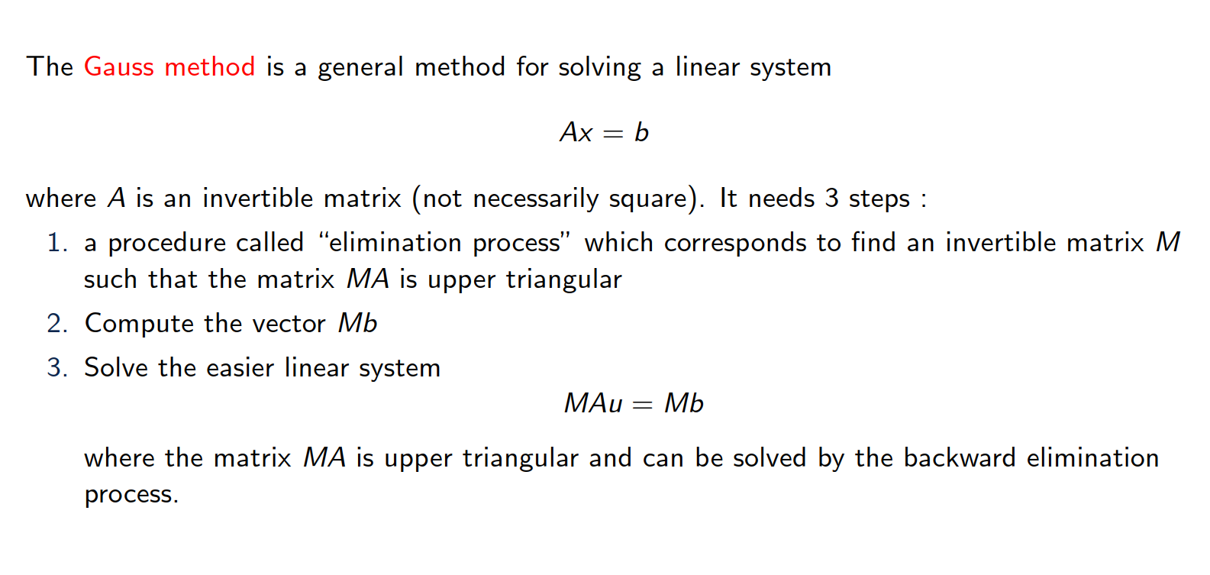
Gauss elimination

Slide 13
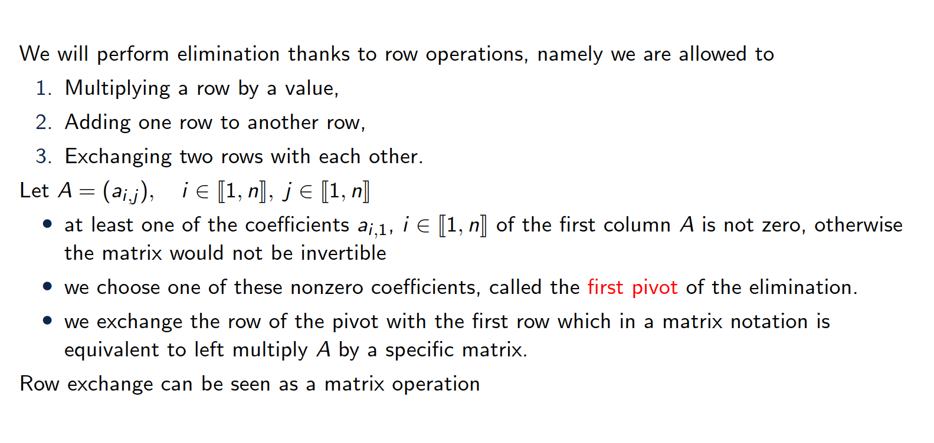
Description of the first step

Slide 14
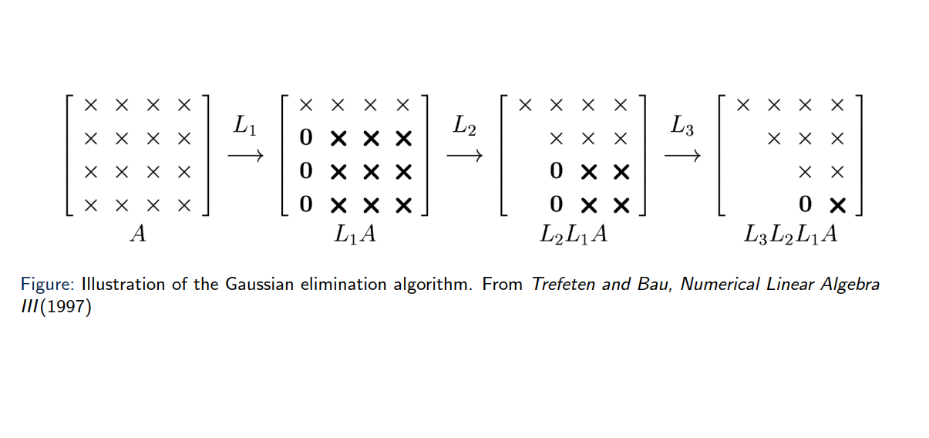
Illustration of the algorithm

Slide 15
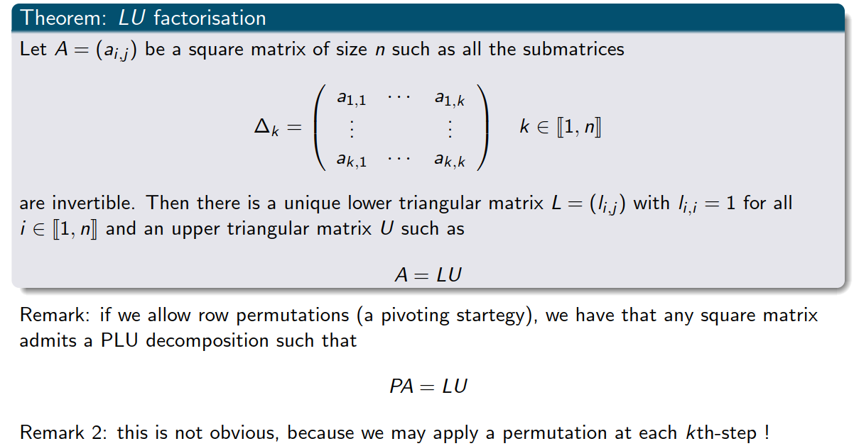
Theorem

Slide 16
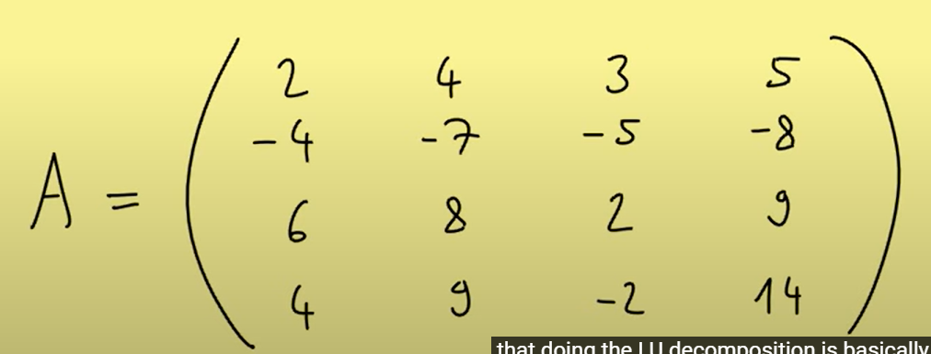
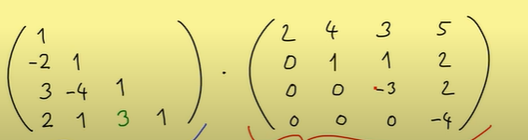


Example 4x4 linear system
Exercise 2
Notes:
Expanded Gaussian elimination

Slide 17
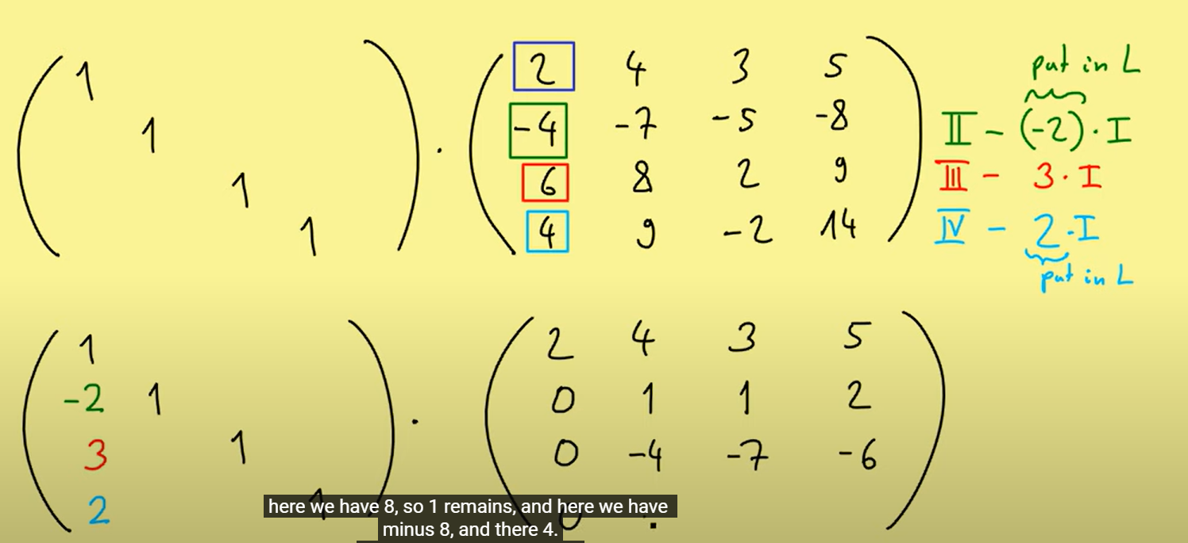
Example 4x4 linear system
Notes:
Expanded Gaussian elimination

Slide 18
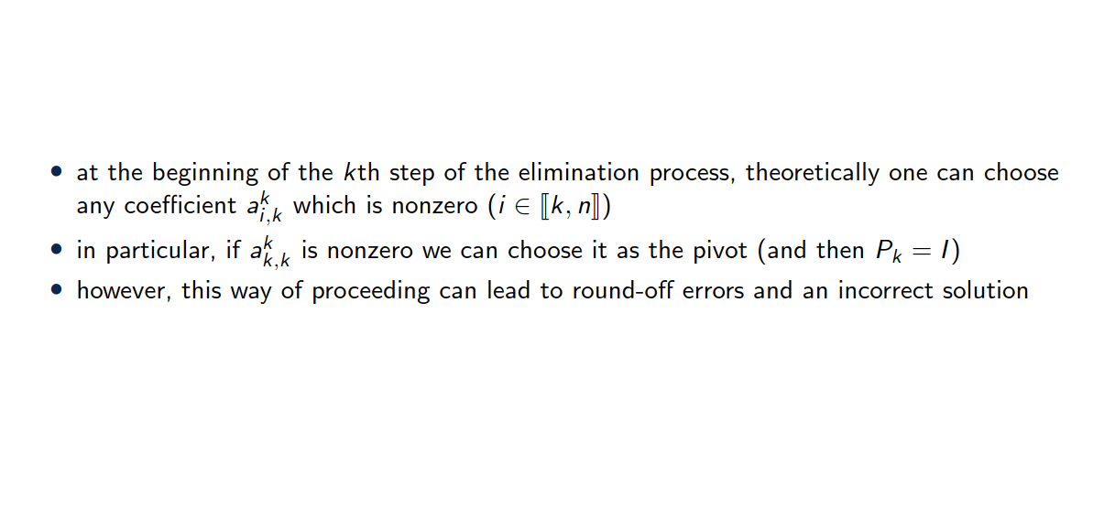
Choice of the pivot

Slide 19
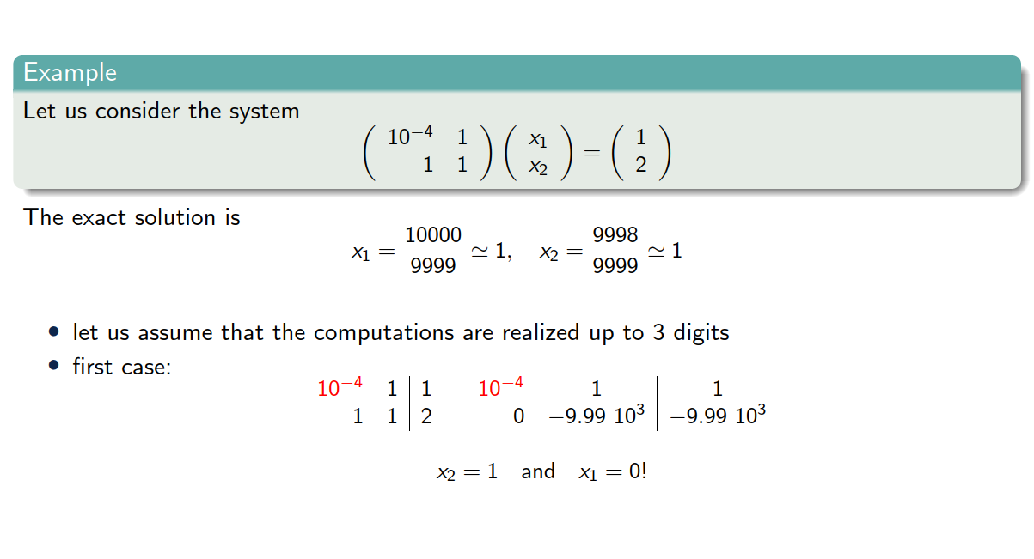
Choice of the pivot

Slide 20
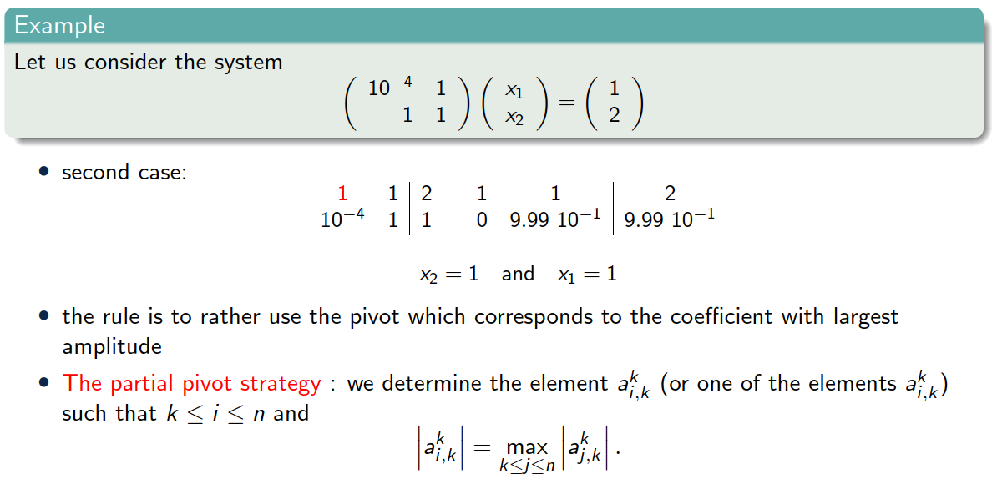
Choice of the pivot

Slide 21
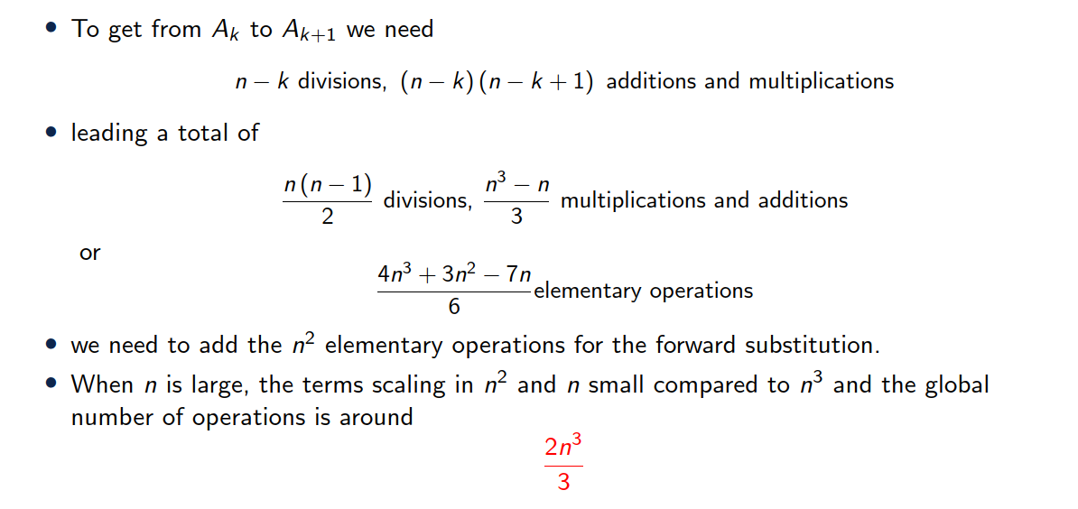
Cost of Gauss method

Slide 22
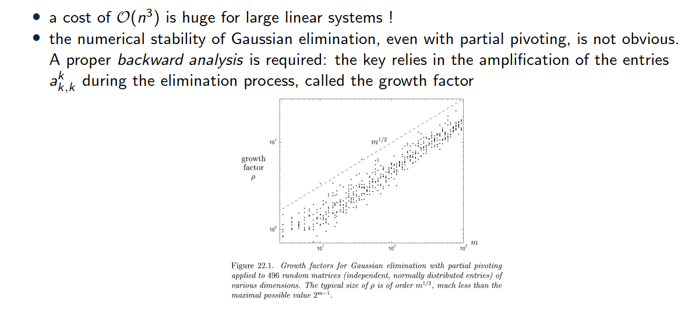
Remarks

Slide 23
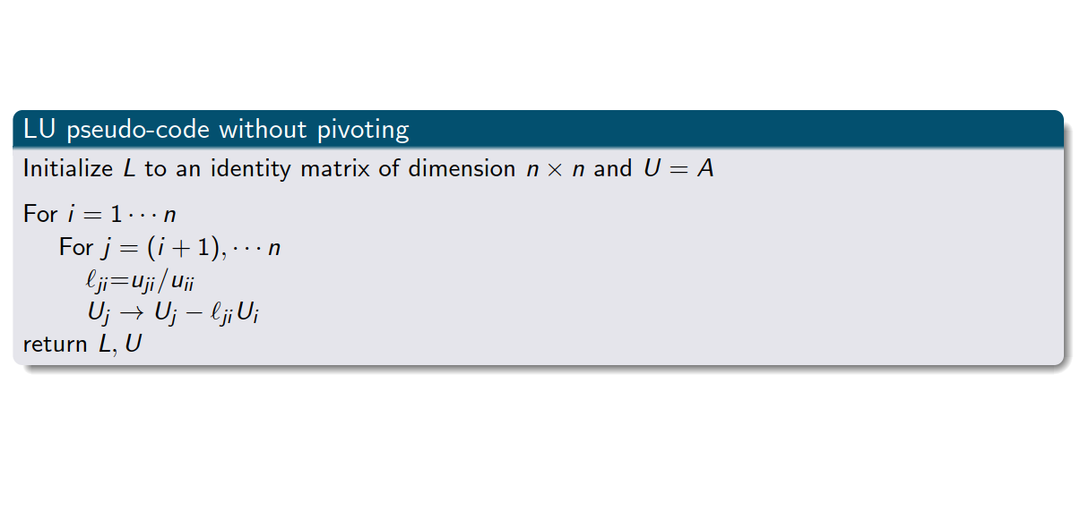
LU factorization pseudo-code
Exercise 2

Slide 24
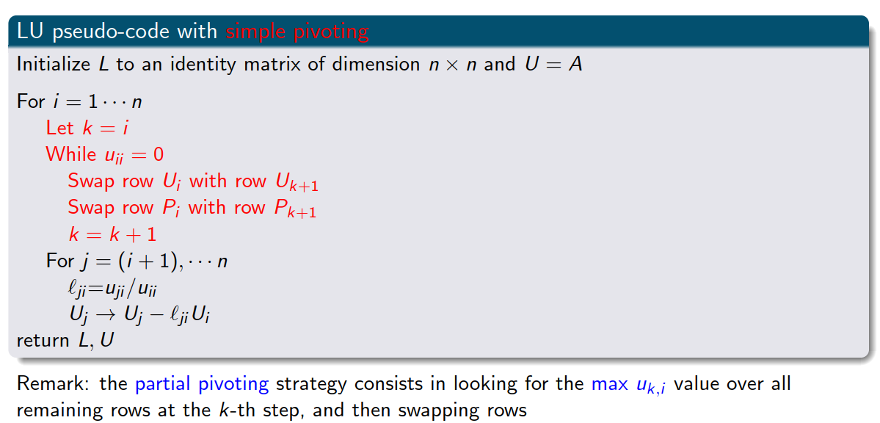
LU factorization pseudo-code with pivoting
Exercise 3

Slide 25
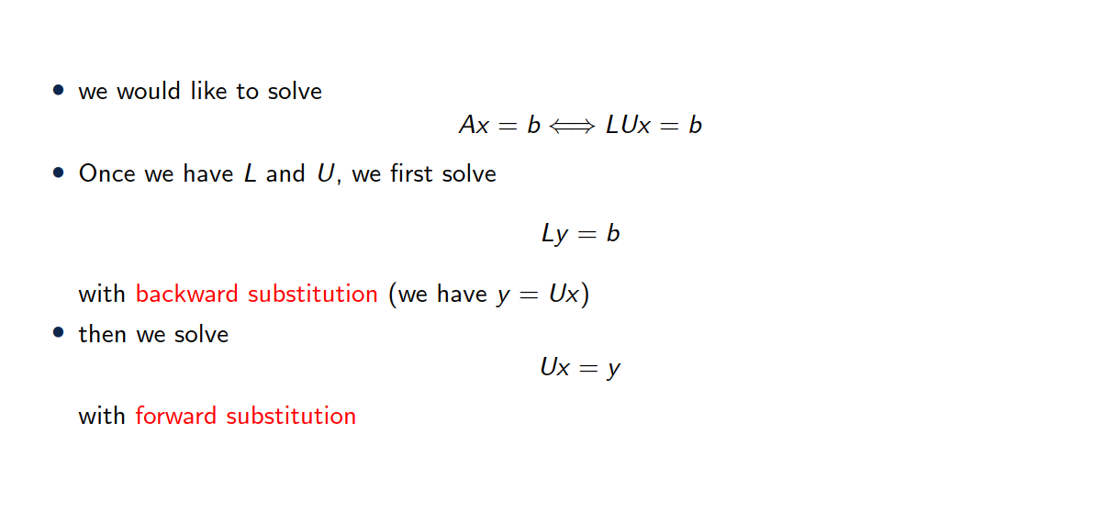
Solving a linear system with LU factorization

Slide 26
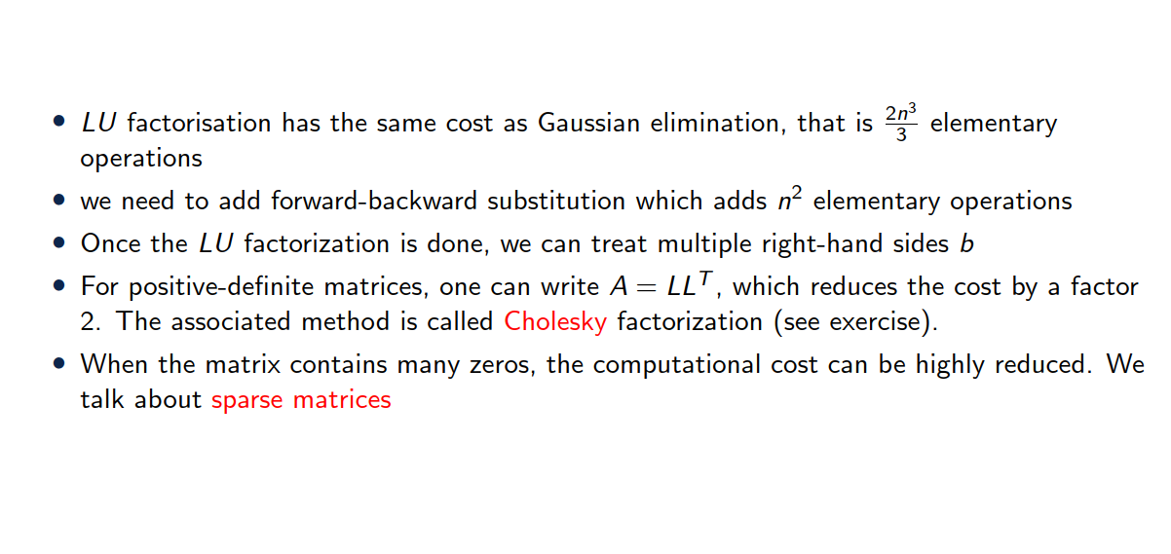
Factorization cost

Slide 27
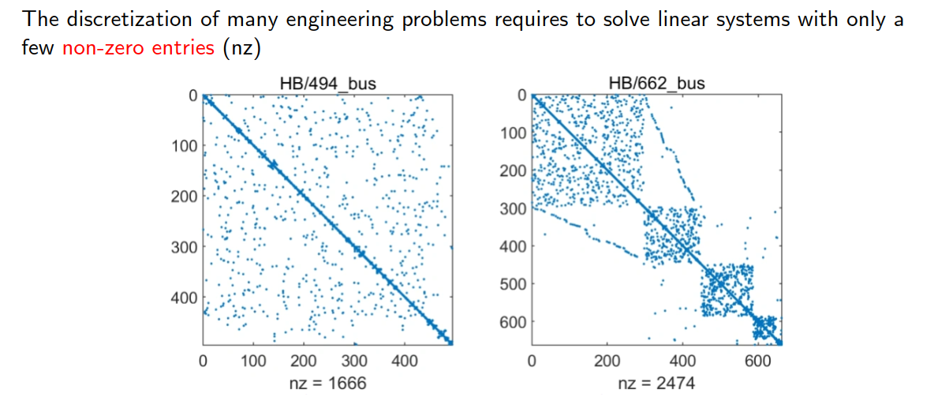
A few words on sparse matrices

Slide 28
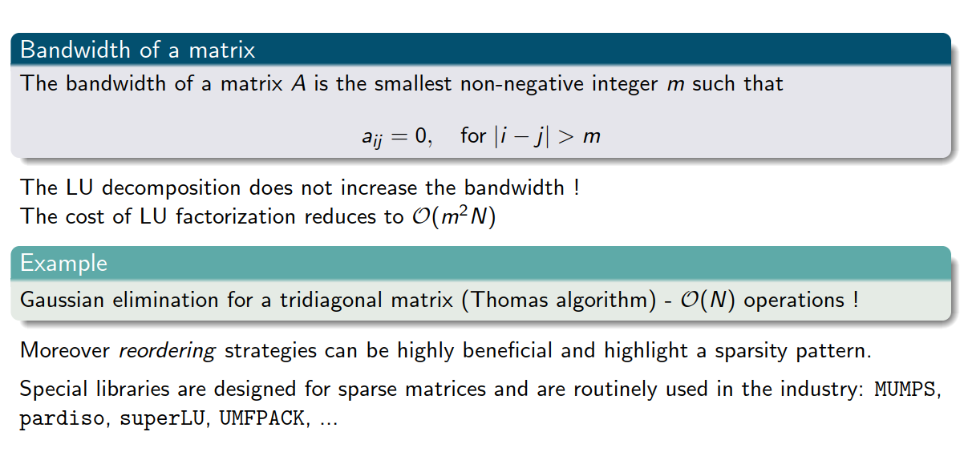
A few words on sparse matrices

Slide 29
3. QR decomposition

Slide 30
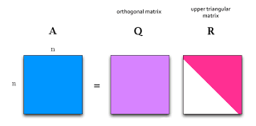

QR decomposition (for square matrices)
Exercise 4
Definition:
Any $n×n$ matrix $A$ can be decomposed into:
$Q$: A matrix with orthonormal columns ($Q^{T}Q=I$)
$R$: An upper triangular matrix
Steps for Decomposition:
Classical Approach: Gram-Schmidt orthogonalization process.
Alternative Methods: Householder reflections or Givens rotations
Applications: Often used in least-squares problems and eigenvalue problems.

Slide 31
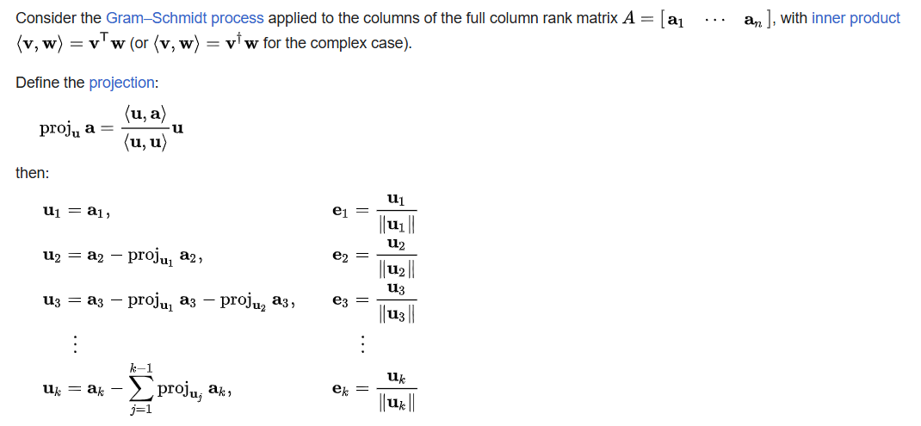
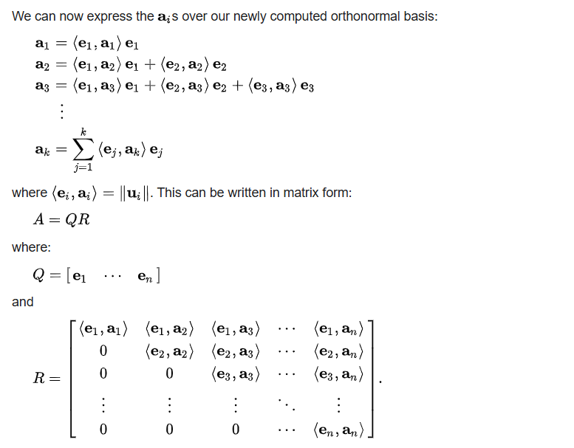
QR decomposition
https://en.wikipedia.org/wiki/QR_decomposition

Slide 32
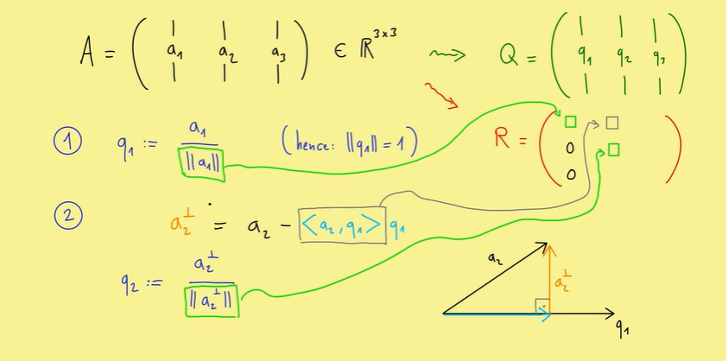
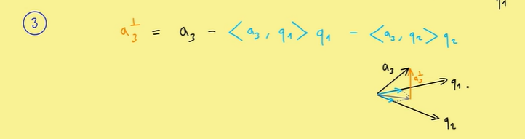
QR algorithm
https://www.youtube.com/watch?v=FAnNBw7d0vg&t=3s

Slide 33
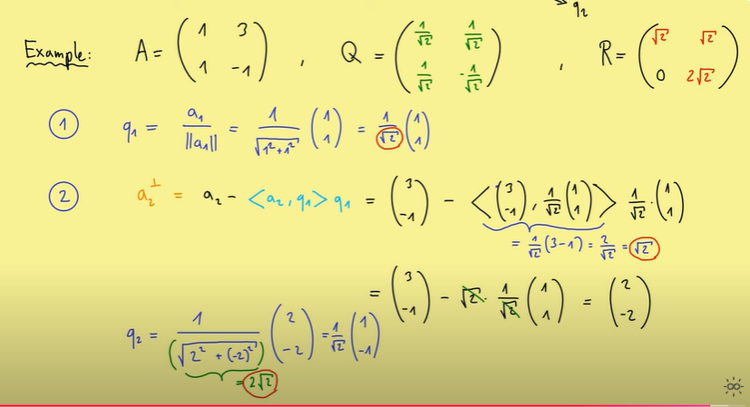
Example (hands on)

Slide 34
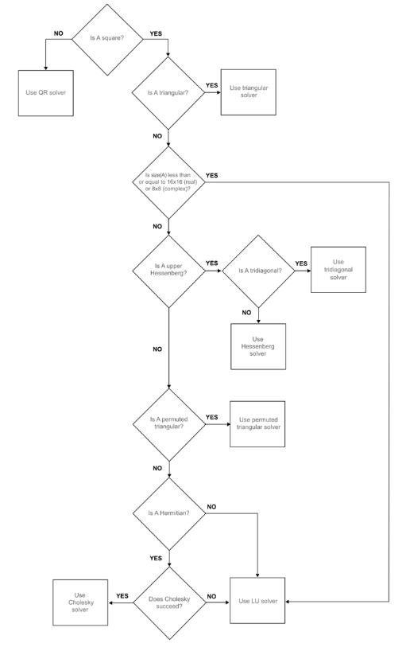
Backslah in Matlab
https://www.mathworks.com/help/matlab/ref/double.ml
divide.html
Decision tree
Use QR solver for non square matrices
Use Cholesky for square symmetric matrices
Use LU otherwise

Slide 35
3. Iterative solvers

Slide 36
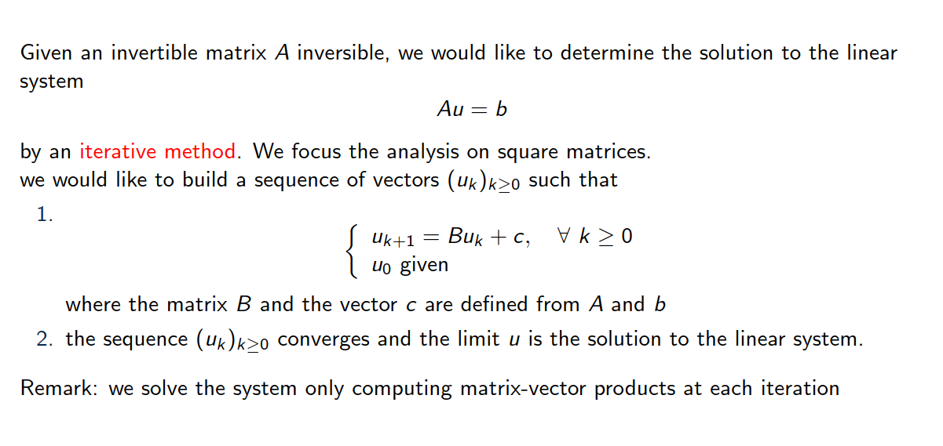
Introduction

Slide 37
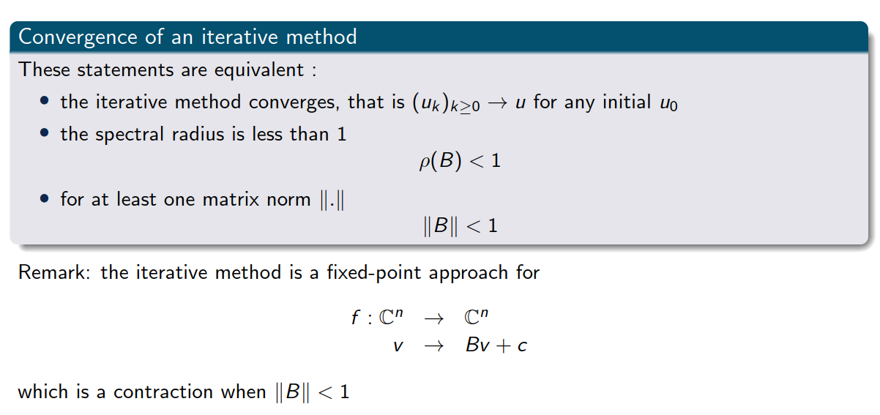
Some basic notions

Slide 38
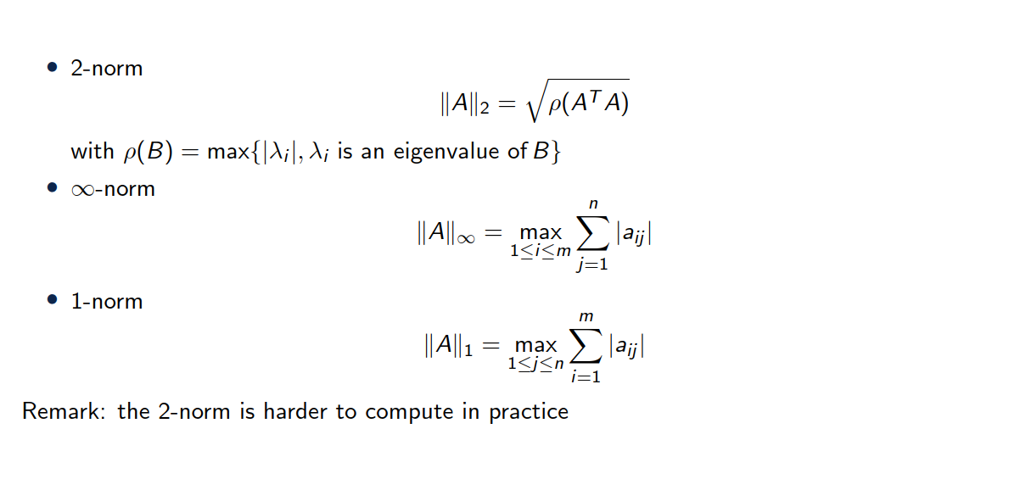
Some induced matrix norms

Slide 39
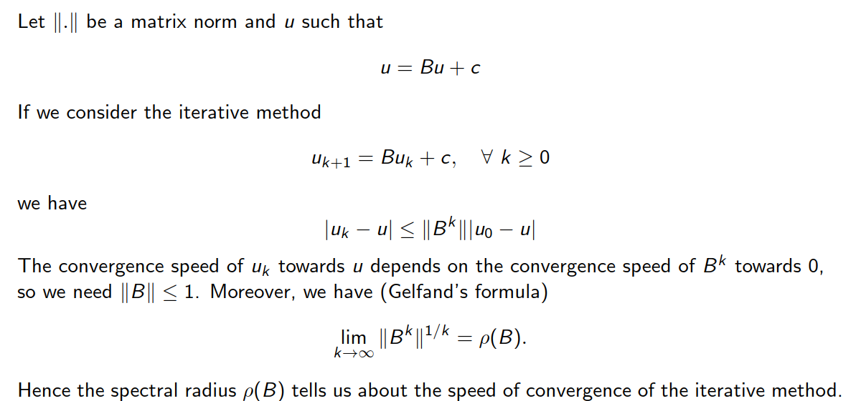
Speed of convergence

Slide 40
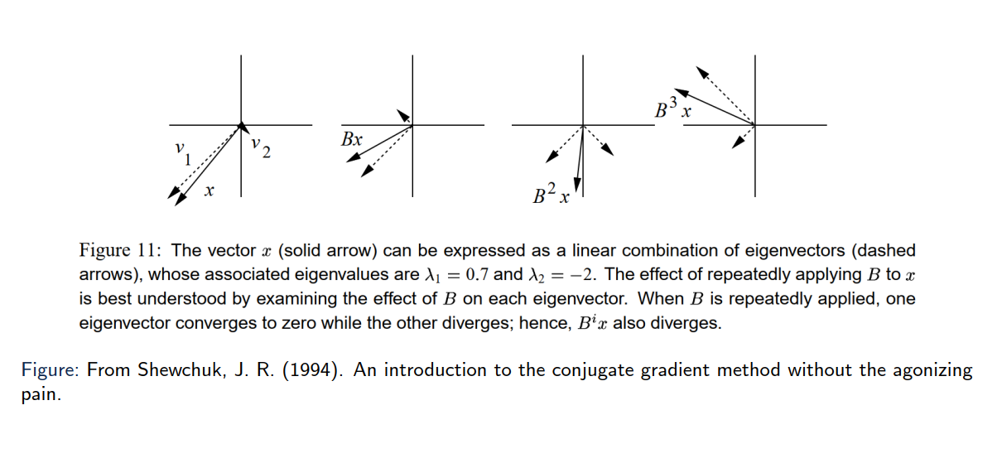
Some basic notions
Eigen vectors only get scaled, not changed in direction!

Slide 41
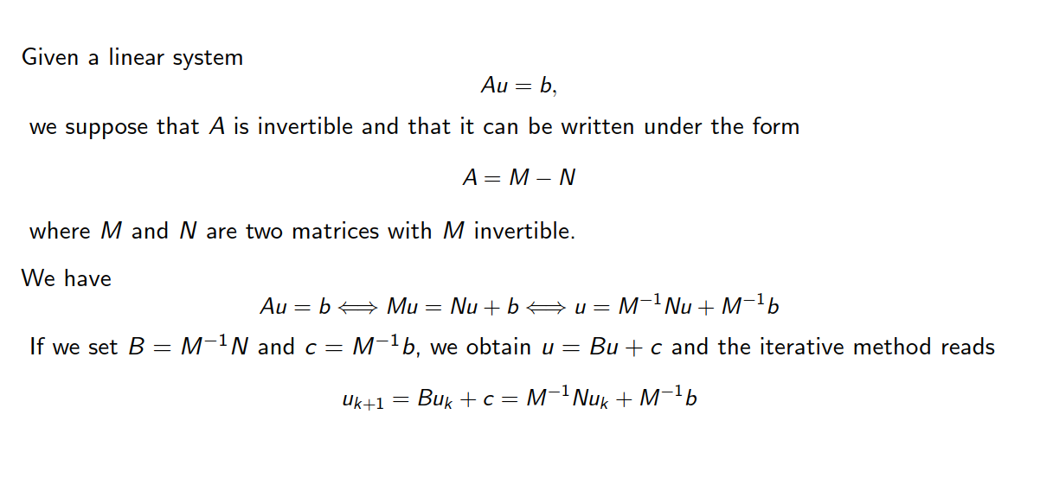
Another matrix decomposition

Slide 42
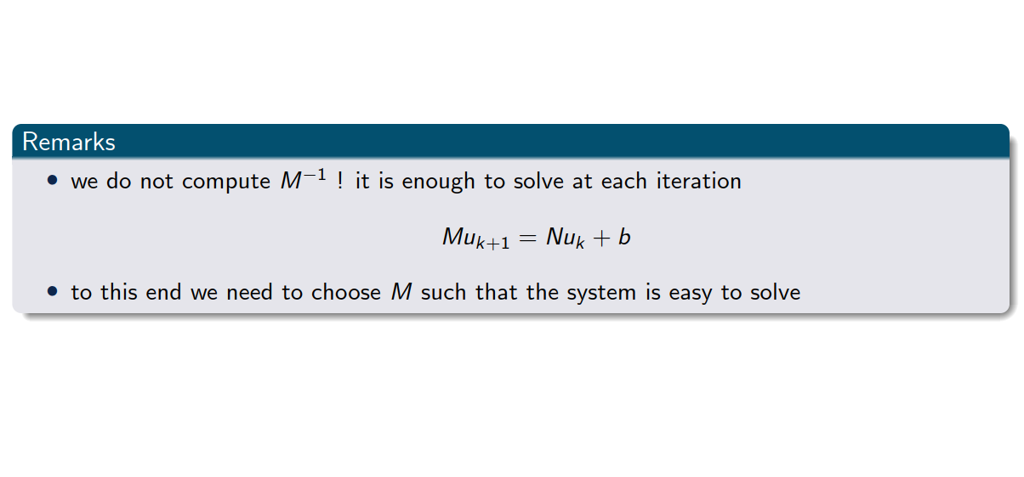
Another matrix decomposition

Slide 43
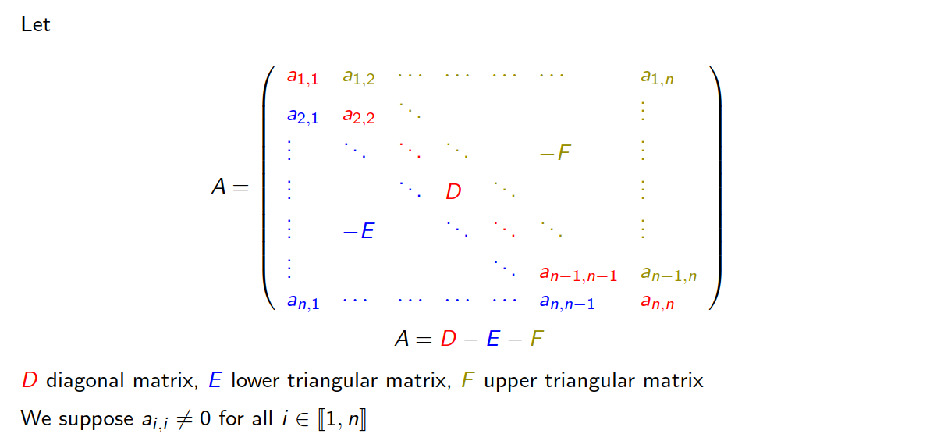
Towards a decomposition of A

Slide 44
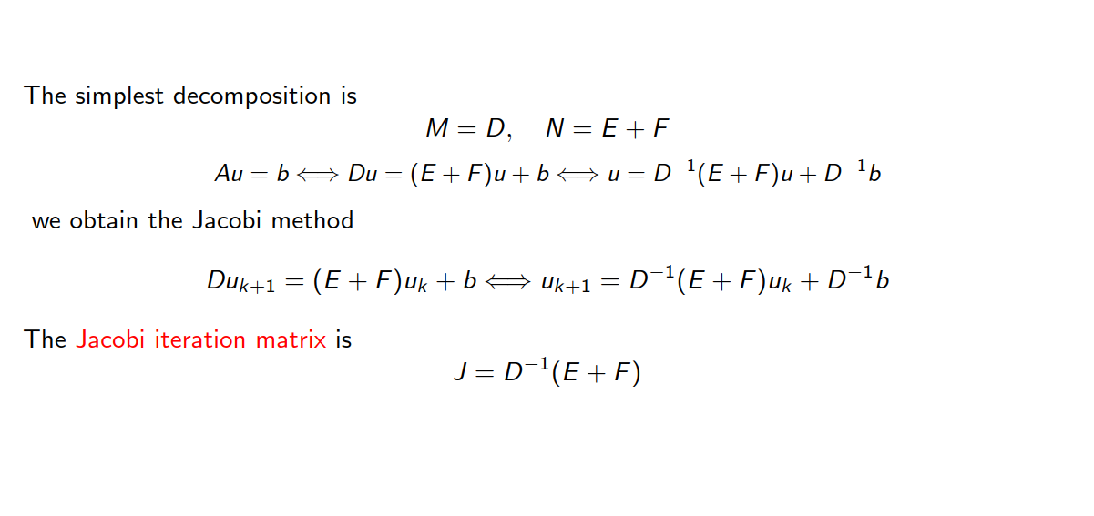
Jacobi iterative method

Slide 45
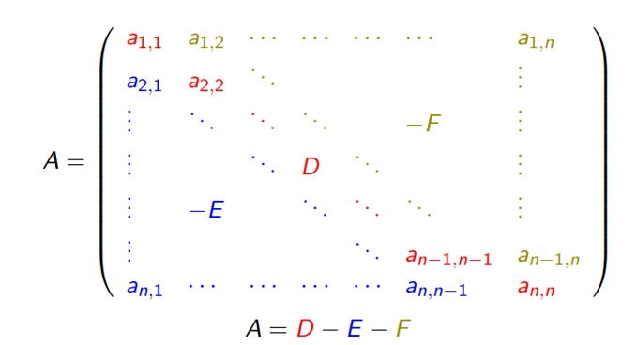
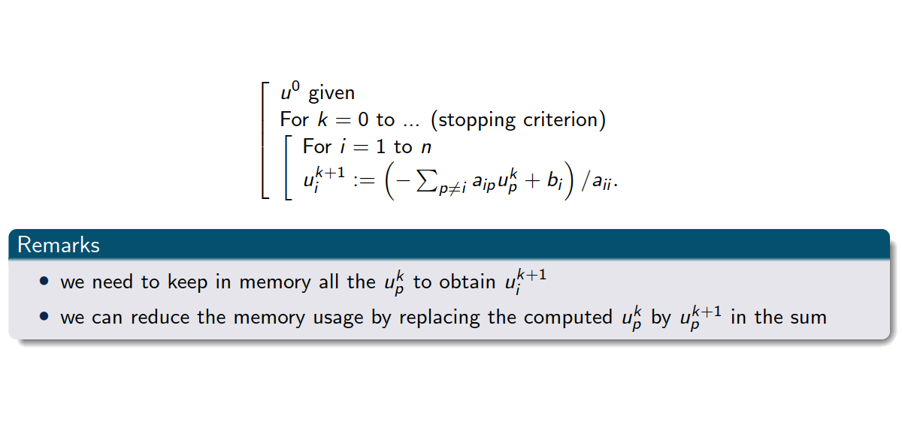
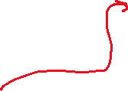
Jacobi iterative method
Pseudo code

Slide 46
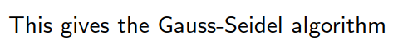

Gauss Seidel algorithm
Pseudo code

Slide 47
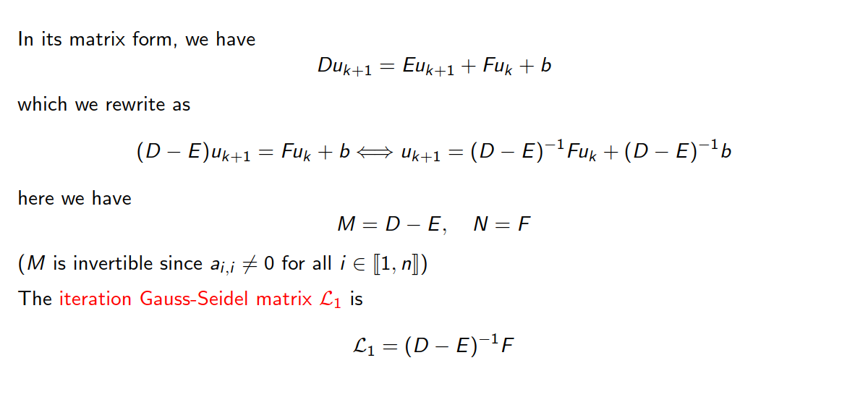
Gauss-Seidel iterative method

Slide 48
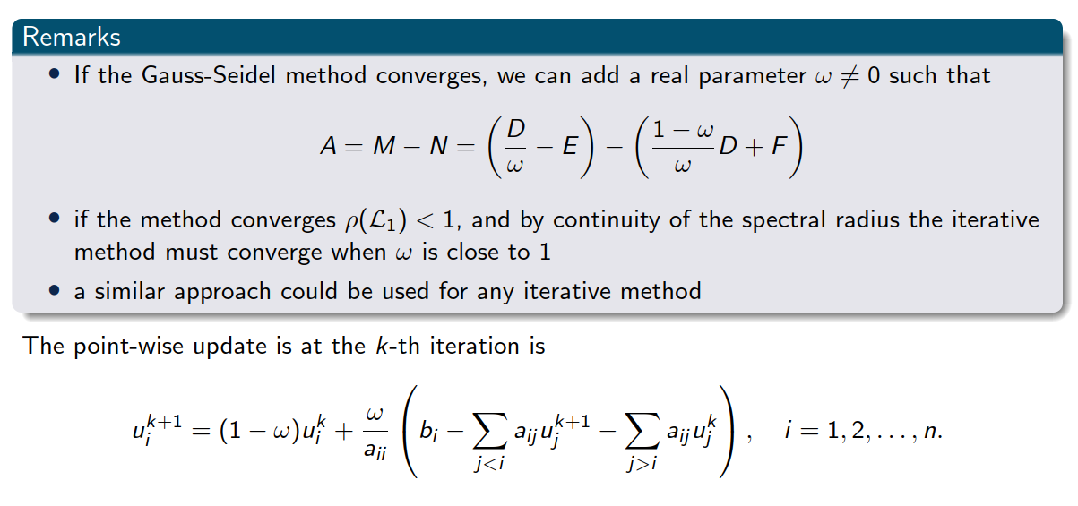
Relaxation method: Successive over-relaxation (SOR)

Slide 49











Relaxation method: Successive over-relaxation (SOR)

Slide 50
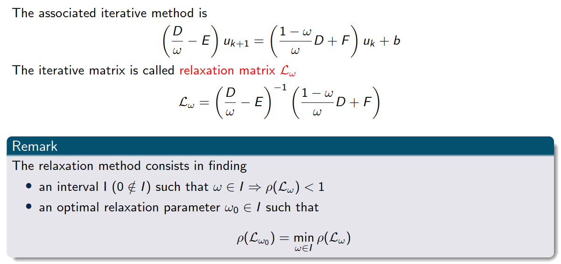
Relaxation method: Successive over-relaxation (SOR)

Slide 51
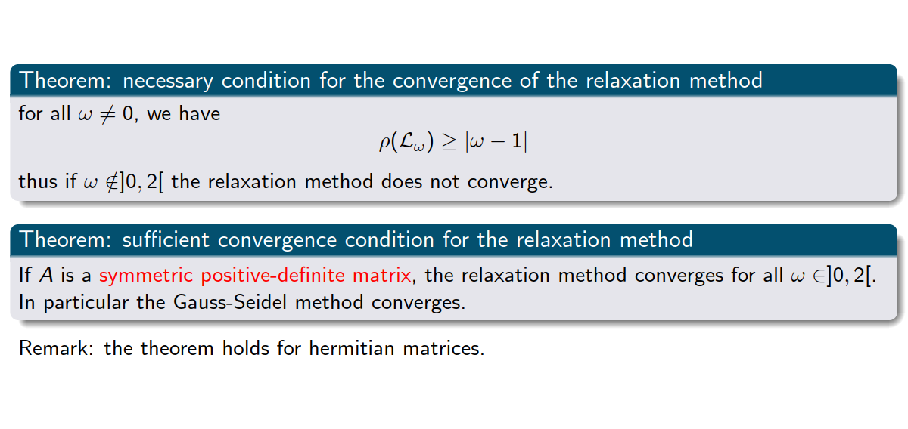
Convergence of SOR

Slide 52
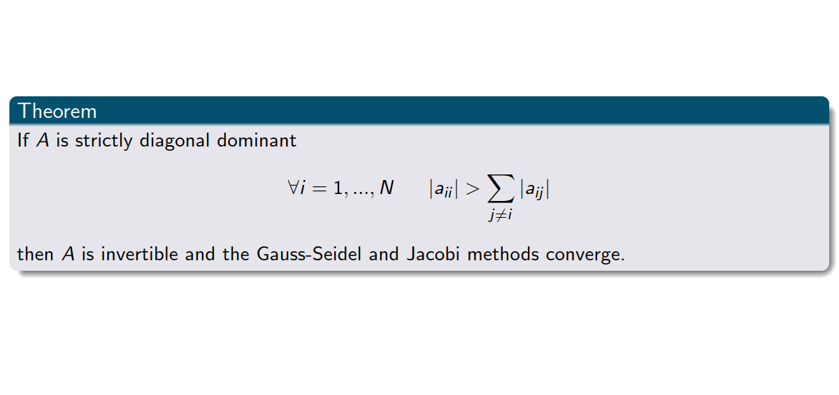
Convergence of Gauss-Seidel and Jacobi

Slide 53

In general

Slide 54

Matrices of type “V”

Slide 55

Matrices of type “V”

Slide 56

A few words about conditioning

Slide 57

A few words about conditioning
Exercise 5

Slide 58
6. Summary

Slide 59

Summary

